Slide 1
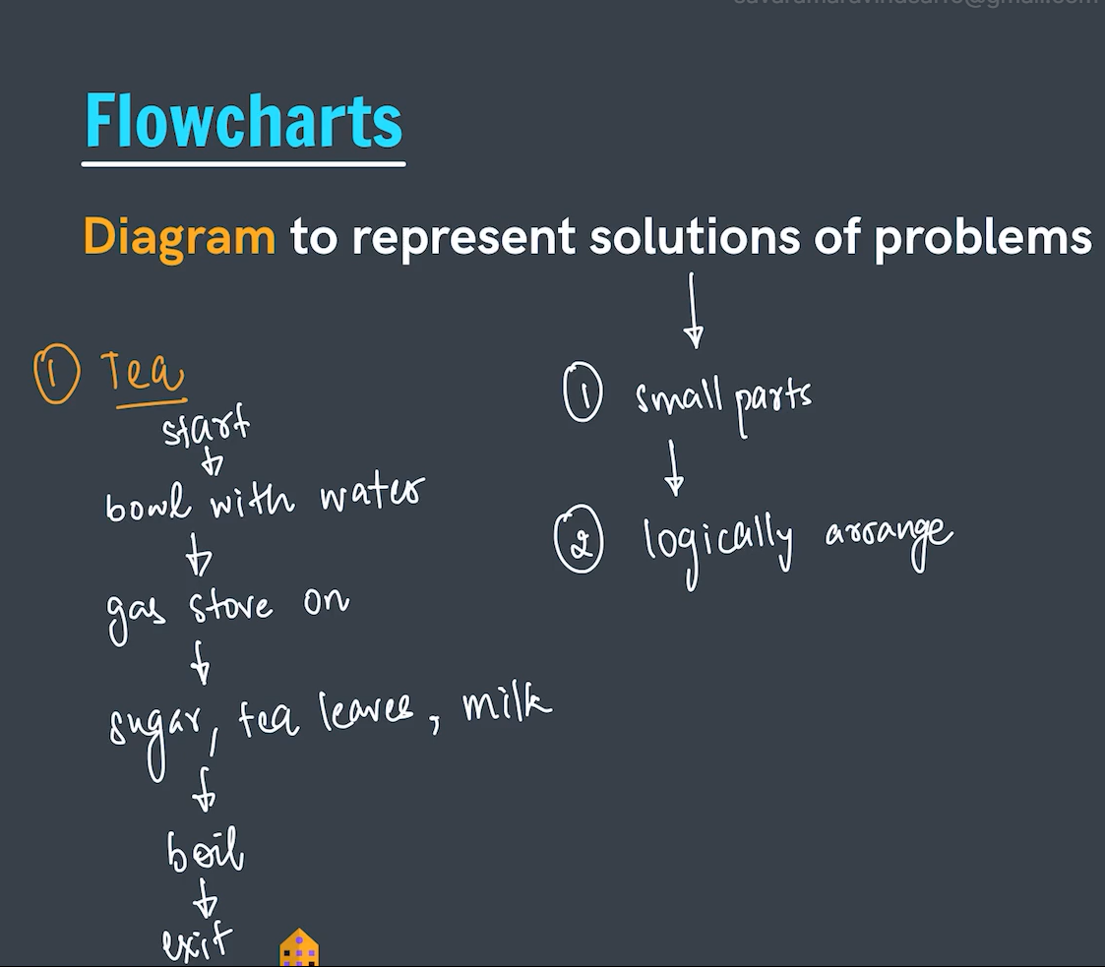
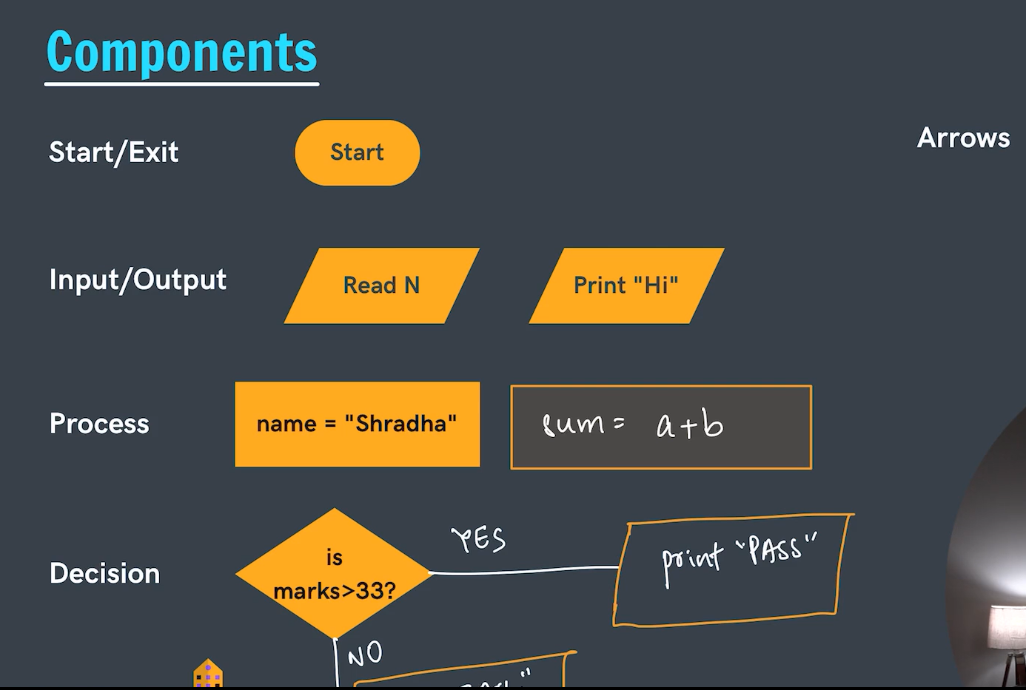
Flowcharts
Notes:
In process we can write any formula, method, assigning etc.
Arrows are used to connect the diagrams (components).

Slide 2
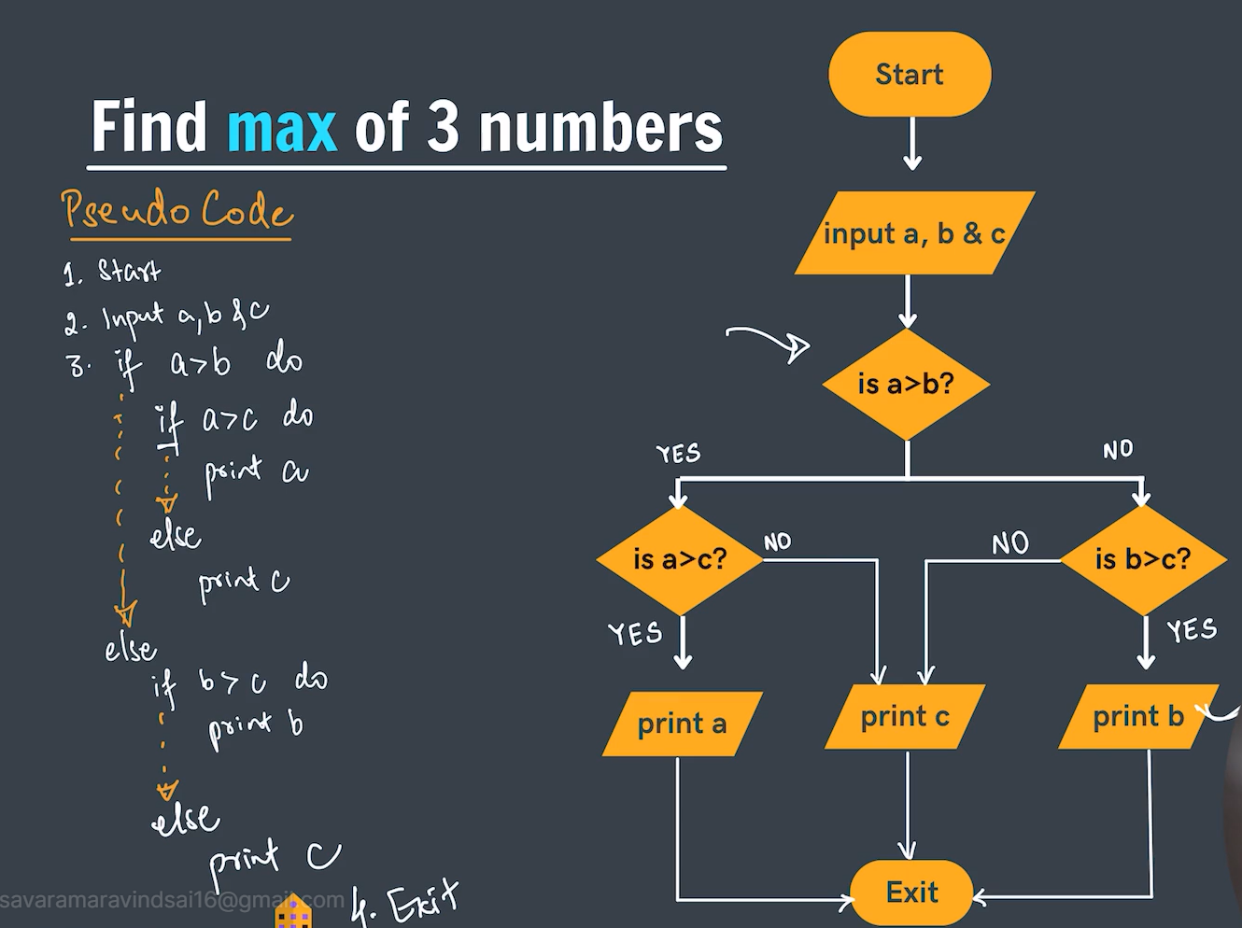
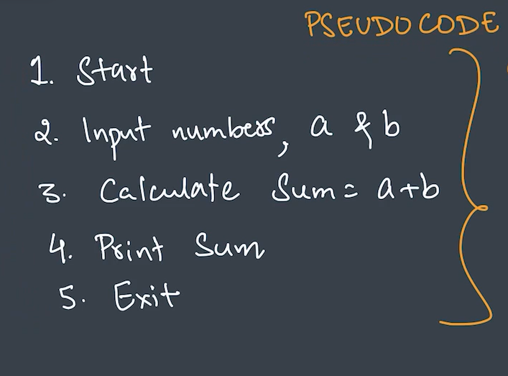
Pseudocodes
Pseudocode is basically writing the flowchart in English.
One example is given above.

Slide 3
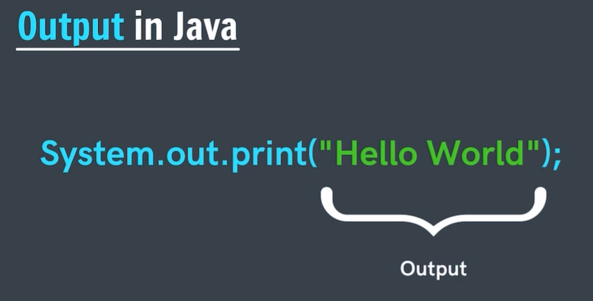
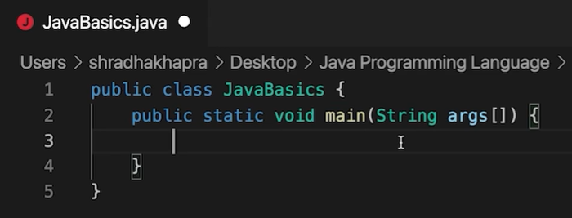
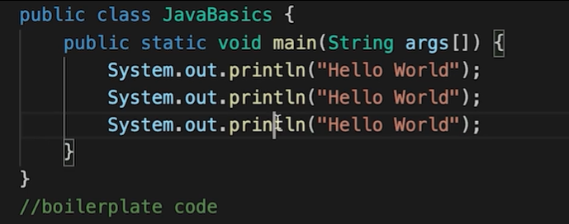
Boilerplate code
Incase of java , whatever code we write , we always write it inside a class the name of the class should be the name of the file. And also in order to compile a code we write javac file_name.
If we want them to be printed on the next line we simply use the command ‘ println ’ or use \n.

Slide 4
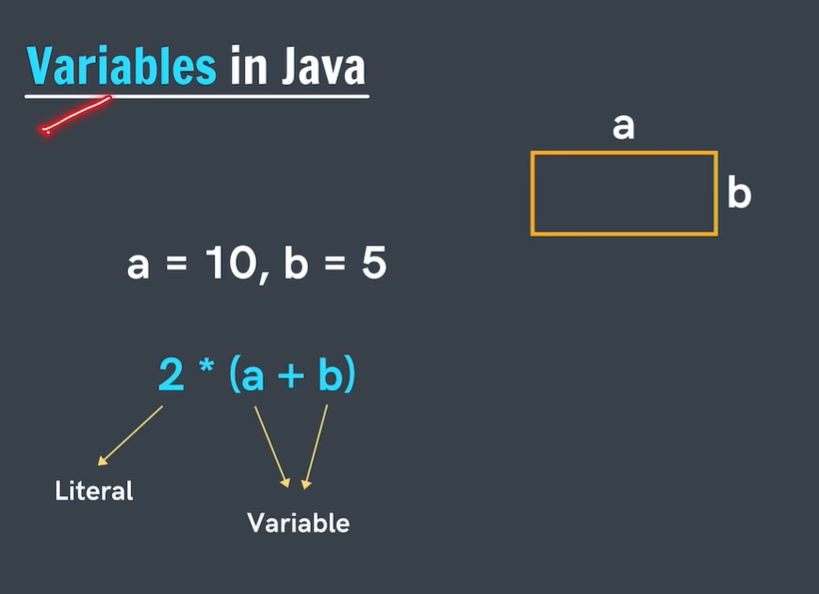
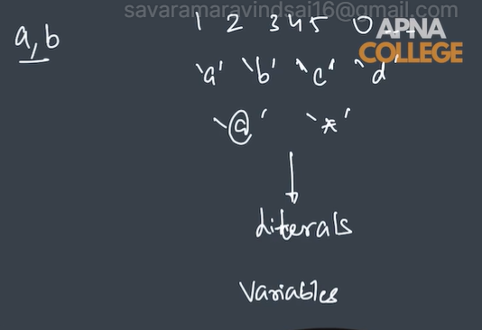
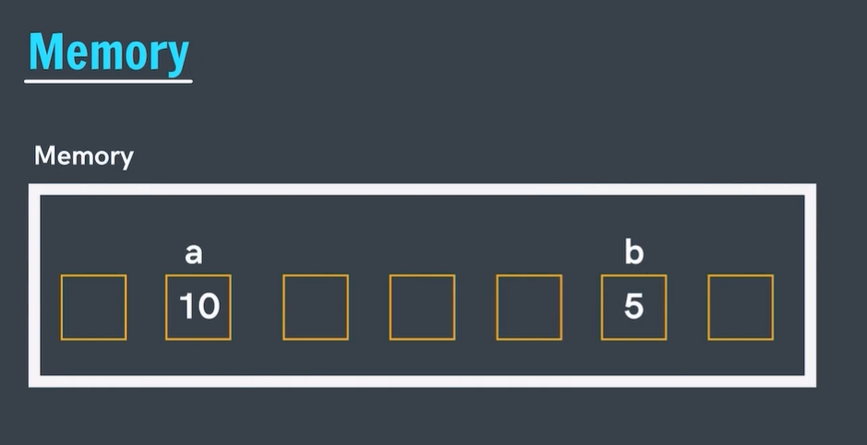
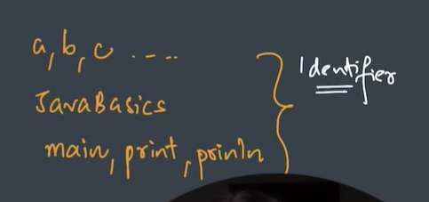
The values which remain same everywhere and are universal are called literals.

Slide 5

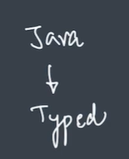
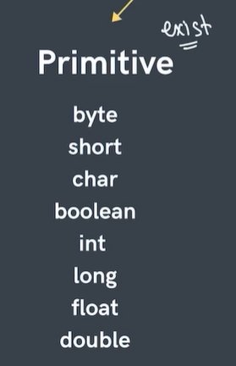
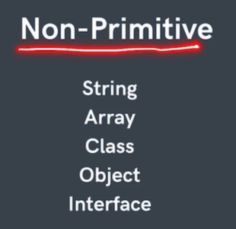
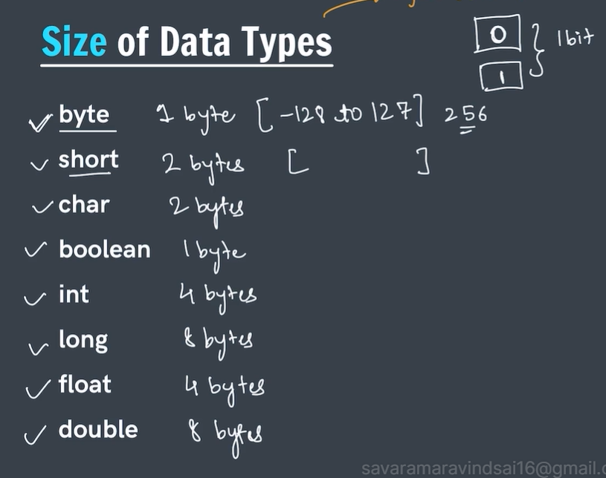
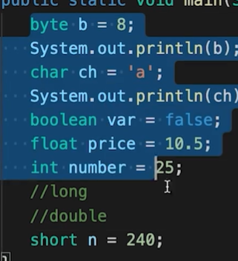
Note that in case of datatype such as long is used to store big integer values whereas the datatype double is used to store big floating values.

Slide 6
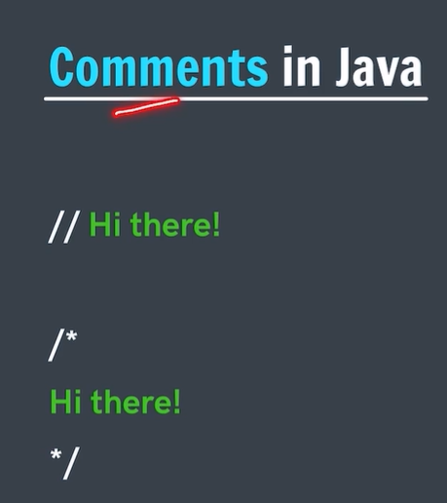
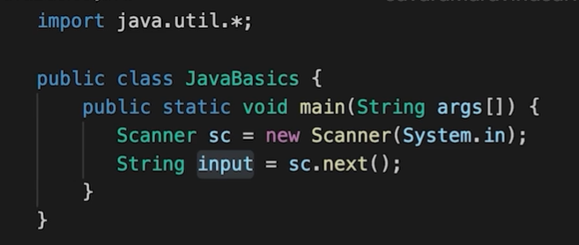
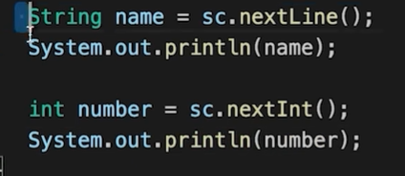
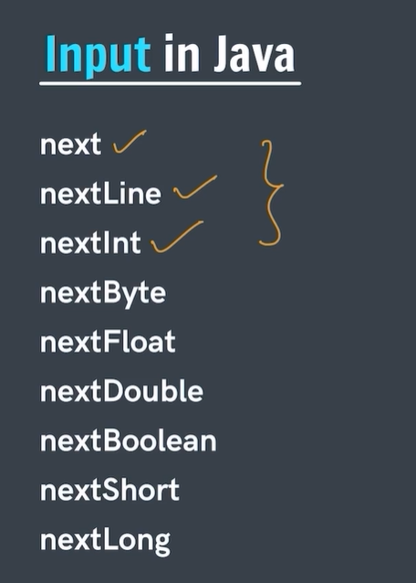
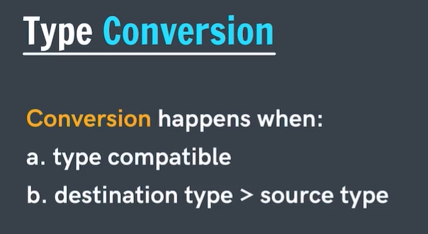
Taking input from the user.
Input in java can be taken from the user using scanner object.and also note that the function next is going to take input only thill spacebar aand agter spacebat it will not consider it.
For spaces to be stored as well ,use the function nextLine.and also java automatically considers every decimal number as double.in order to convert it into float we write f at the end of the number.

Slide 7

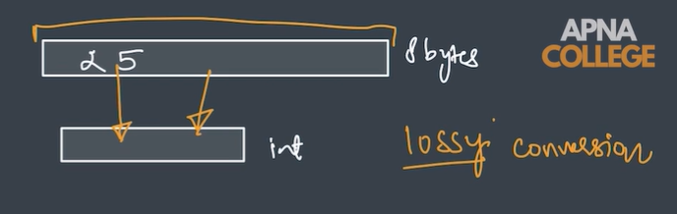

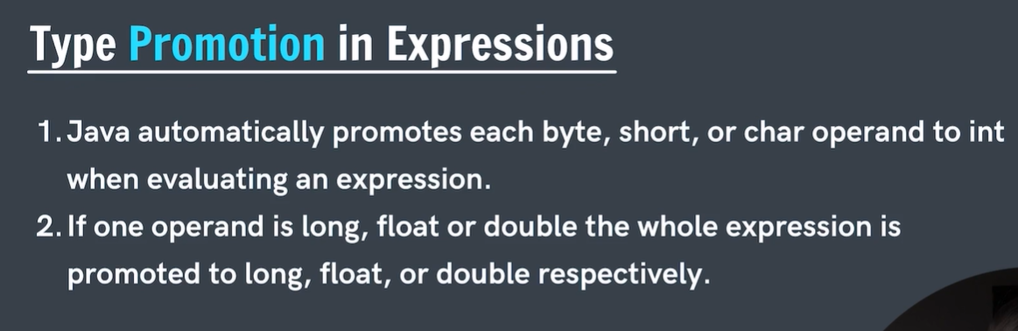
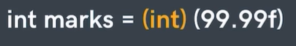

Note that the reverse order is not possible due to lossy conversion in java. So in short byte can be stored in long whereas the reverse cannot happen , the reason being due to the size . Also this is also known as widening conversion or implicit conversion whereas type casting is also known as explicit conversion or narrowing conversion.

Slide 8
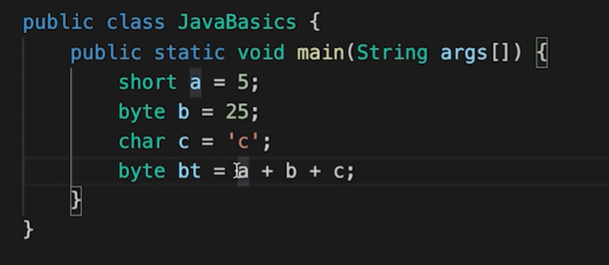
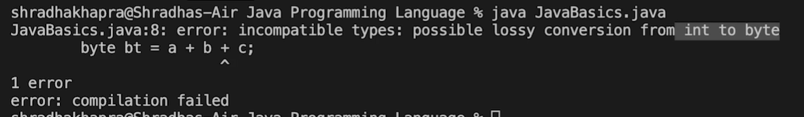

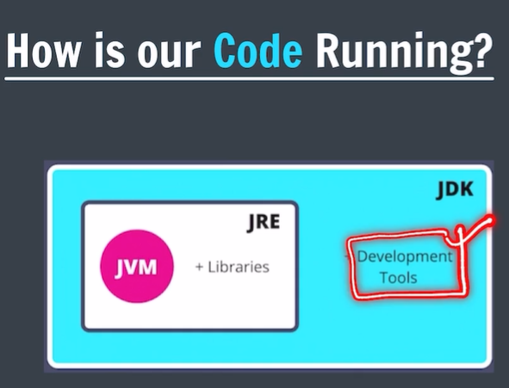
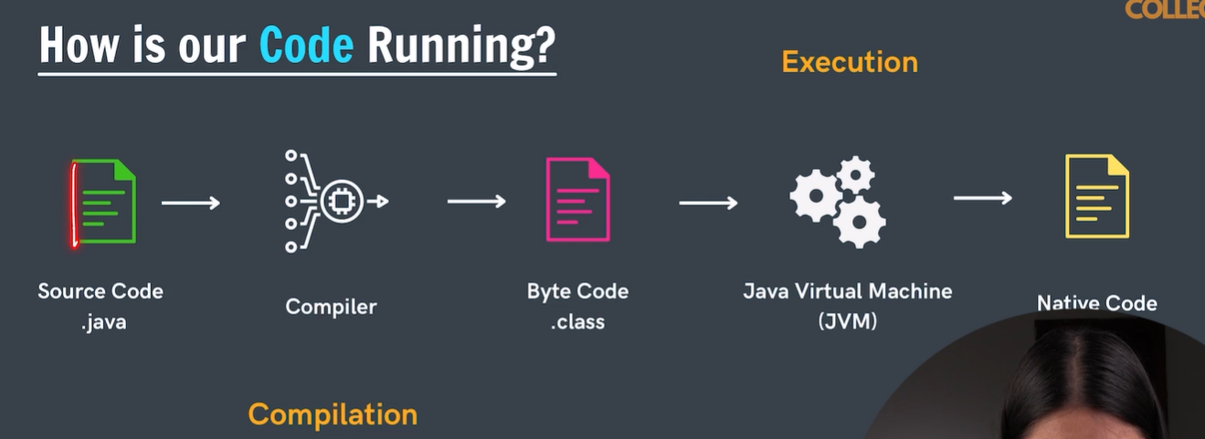

Slide 9
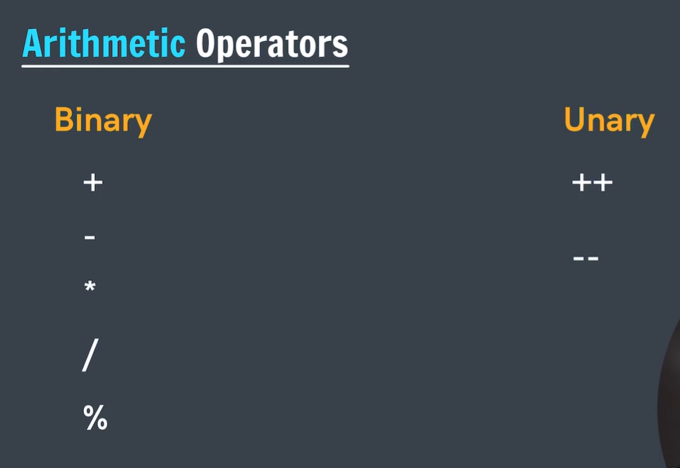
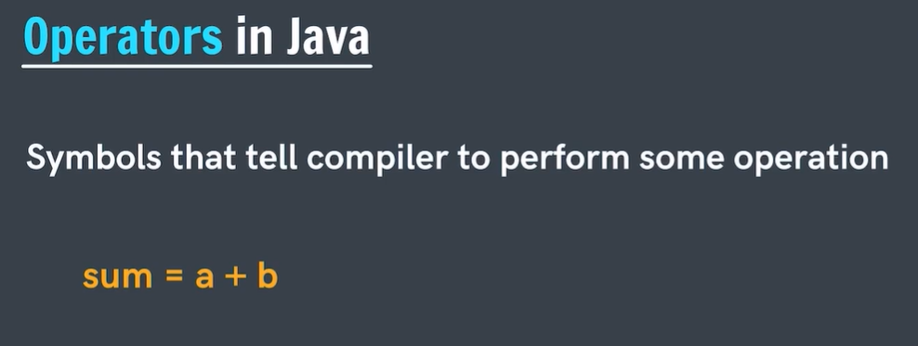
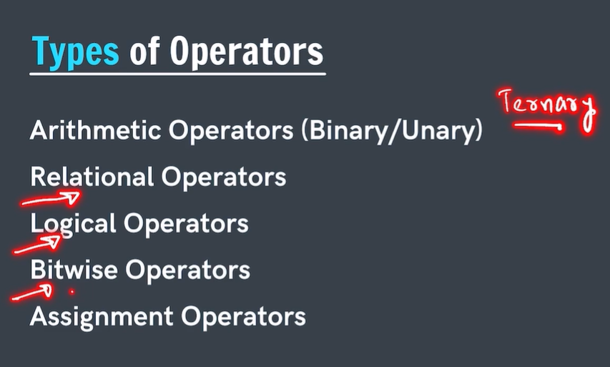
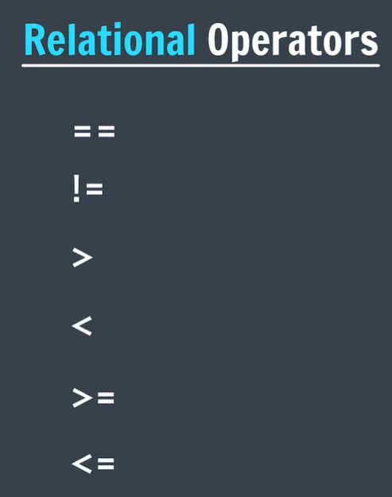
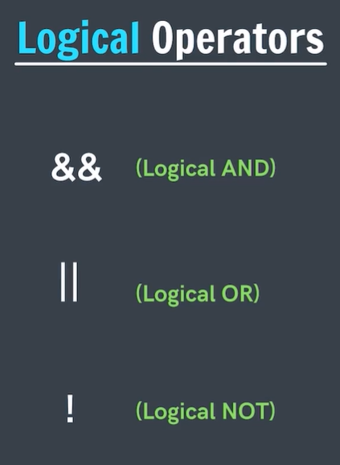
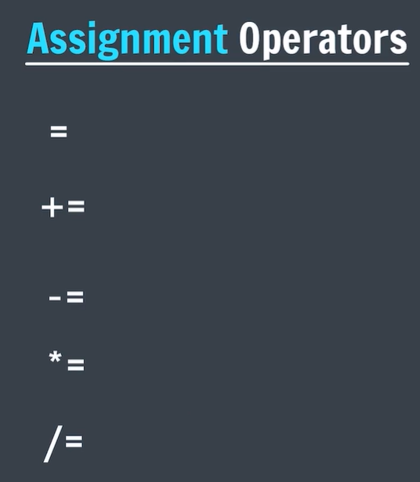

Slide 10
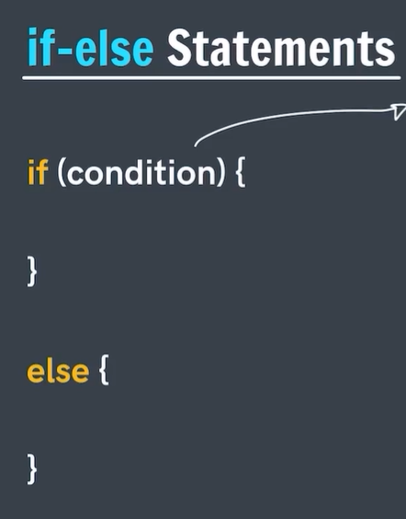
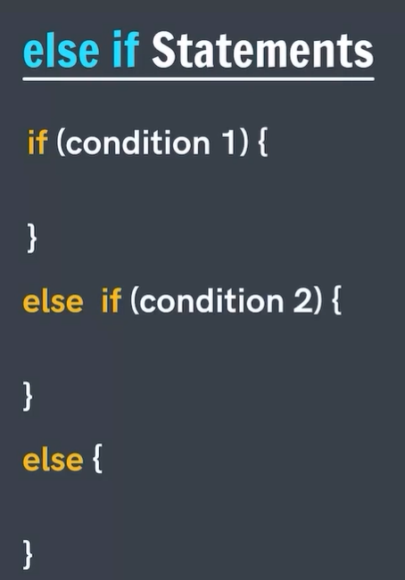
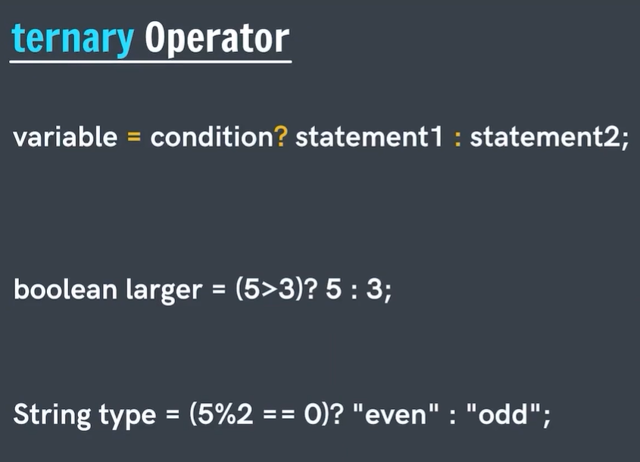
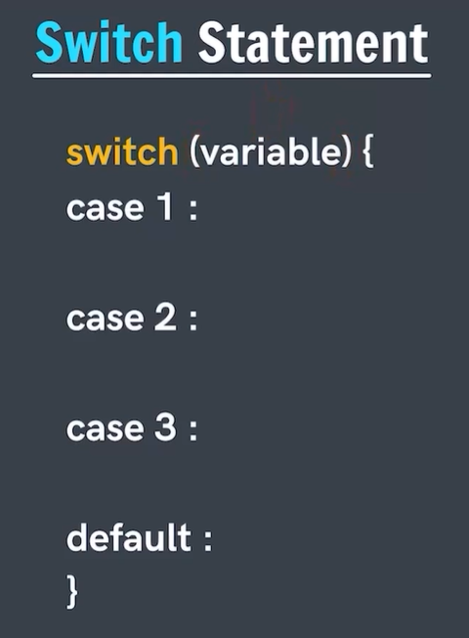
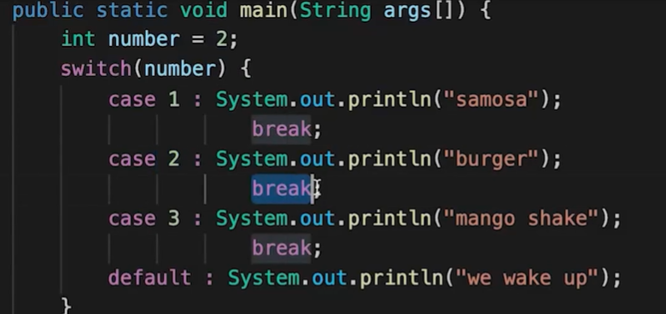

Slide 11
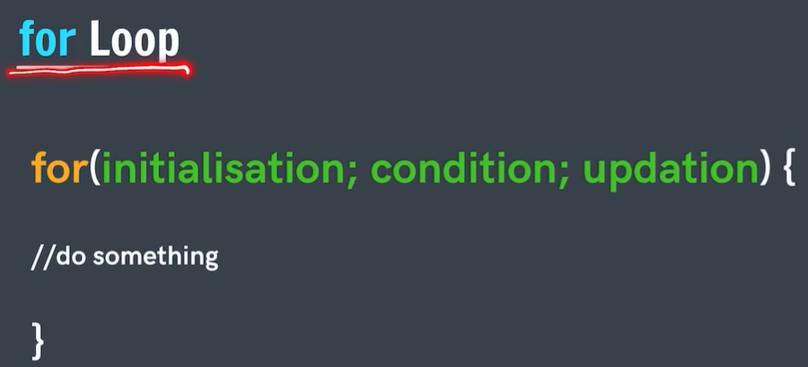

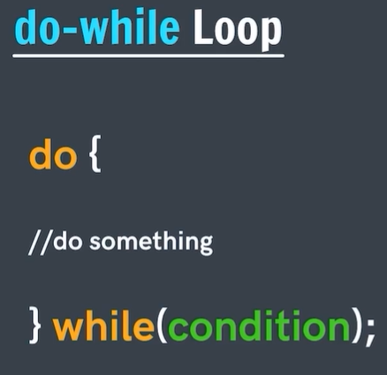
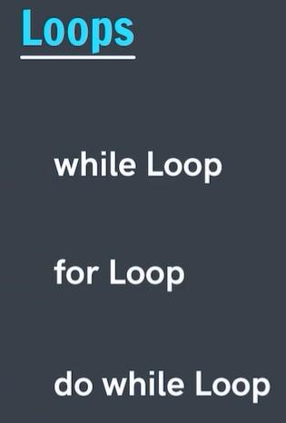
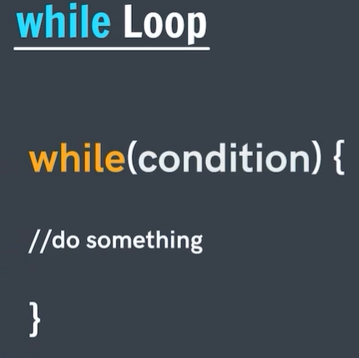

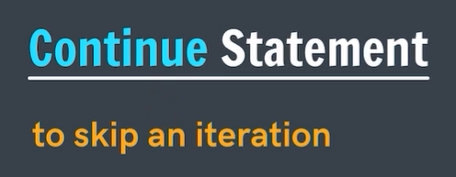

Slide 12
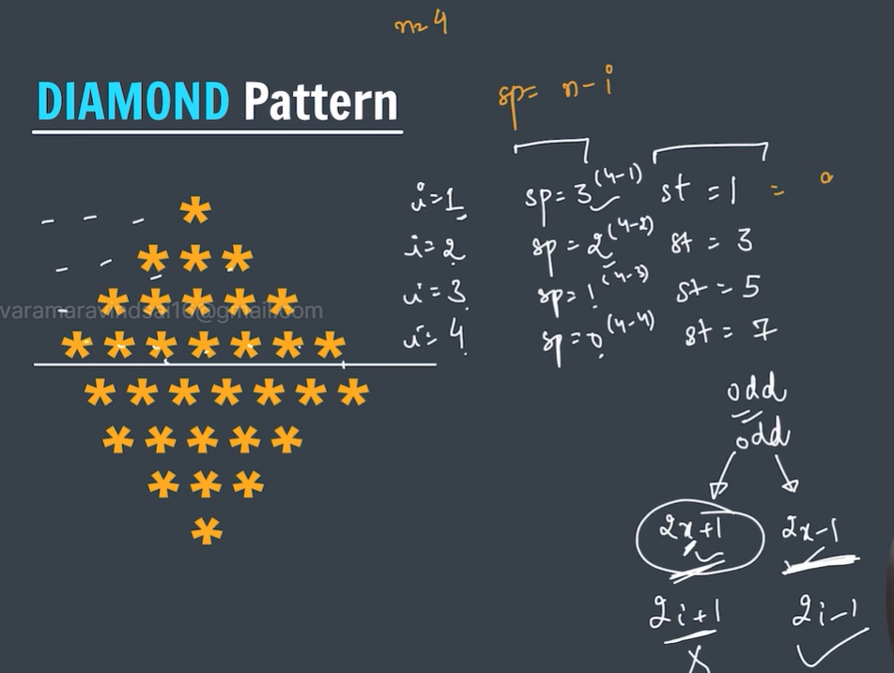
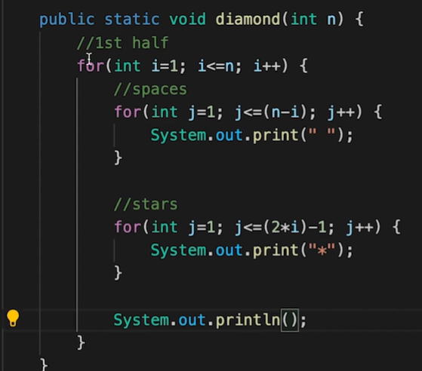

Slide 13

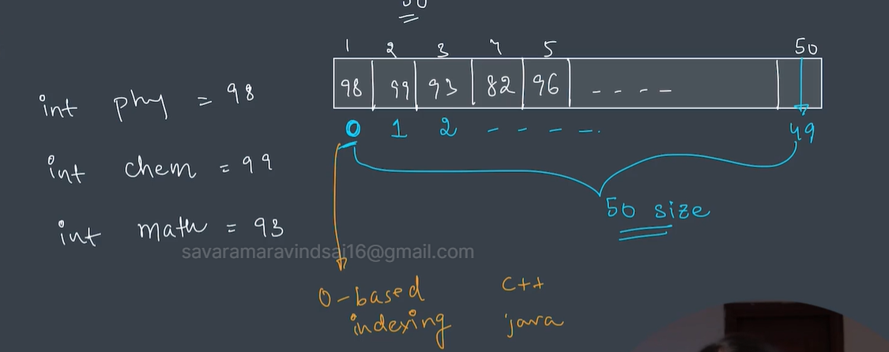
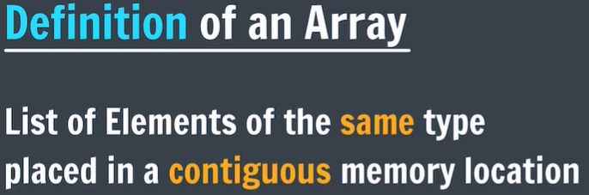
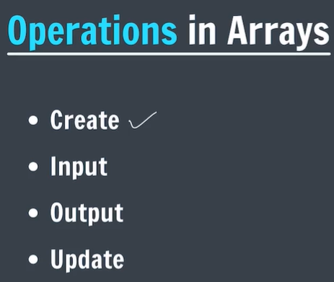
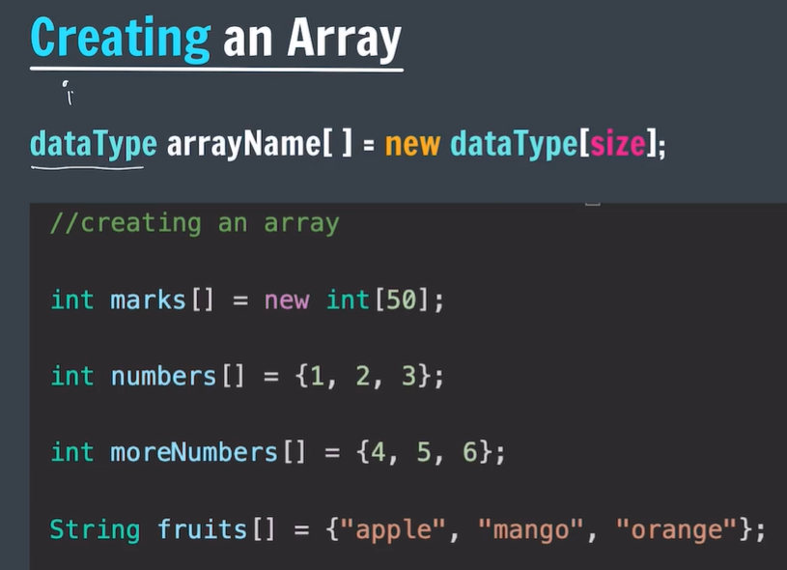
Note that arrays are static which means that the size of the array cannot be changed while running the code but can only be changed at the beginning of the code itself .length is used for calculating the length of an array.

Slide 14





Note that whenever array is passed into a function then it is usually passed as reference.so what changes occur at a function , it also get reflected on the main function.

Slide 15



Note that the time taken which is time complexity for binary search is better than that of the linear search and hence binary search is better than that of linear search
Note that the time complexity of the question of pairs in an array is O(n^2).also the number of pairs can be obtained by the formula n(n-1)/2.

Slide 16




Note that the maximum number of subarrays can be obtained by the formula n(n+1)/2.

Slide 17





Note for this the time complexity will be big oh of n^3 which is not very good , the better approach will be the prefix sum approach where we basically store the sum till the i th element.

Slide 18





Kadane’s algorithm

Slide 19






In order to calculate the max left boundary and the max right boundary we use auxillary arrays.

Slide 20







Slide 21





Slide 22




These methods are used to sort an array in ascending order and in particularly in the second method the ending index is not inclusive so we need to add 1 to it.

Slide 23



Note that the reverse order always work on objects and therefore we need to write Integer instead of int which is a primitive type. Counting sort is usually used In those cases where the range between min and max is small.

Slide 24



Taking input from the user dynamically from the user.

Slide 25



Generally 2D arrays in memory can be stored in multiple ways and among them the most common methods are row major and column major. But in java , they are stored in neither of the above two ways. They need not be stored in continuous fashion but can be stored in different locations

Slide 26




Slide 27





Note that .next is used to take a string as input. However it only takes one word as input but if we use .nextLine we can take a whole line as input.
Taking input as a string. Note that string is a class

Slide 28





Note that incase of arrays . Length is a property whereas in case of string since string is a class , hence .length() should be used as it a function , to be more precise a method.
String concatenation
Just like in an array where we look at each element , in string also we can perform the same operation using a special function known as .charAt().
String Comparison

Slide 29



Hence in order to check whether two strings are equal or not we need to use the function .equals() which returns a Boolean type as an answer.it only checks the value of the two strings
String substrings
Note that in java whenever we want to get a substring of a string we can use the function substring() where we need to pass starting index and ending index which is not included as parameters.

Slide 30




Here the output is mango since the strings are being compared to each other lexicographically and not by size.
Note that in the above case the strings are being compared lexicographically and also the case which is whether it is upper case or lower case is also being considered whereas in case of function such as ComparetoIgnorecase () case is not being considered.

Slide 31



Interning is basically pointing to already existing thing in the heap memory by two or variables in the stack memory. Note that the computer has two types of memory one is heap memory and the other is stack memory. Heap memory is the one which stores all the strings and hence it is known as string pool or intern pool. Also note that the strings are immutable which means that they get copied to a new string every time in a loop . So the copying time is directly proportional to length of the string and it is being copied n times and hence its time complexity is quadratic.
String builder just like is string is another data structure but the only difference is that if it is once created it can modified which means that in simple terms it is mutable unlike strings which are immutable.

Slide 32





Slide 33




Slide 34






Slide 35






